Slide 1
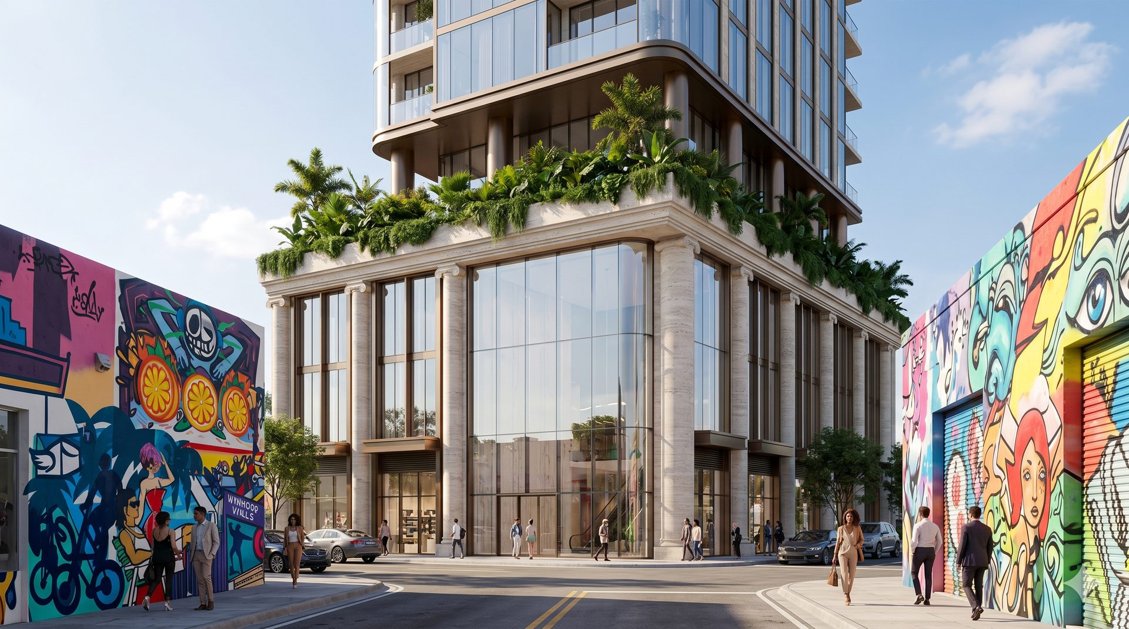

A WELLNESS FRANCHISE GROUP COMPANY
RegenHealth
Physicians
Physician-Led Regenerative Medicine & Longevity Platform
Confidential Investor Presentation · April 2026
James Zimbler, CEO · Dr. Ajit Dhaliwal, MD — CMO · Vincent Butta, COO
$3.25M
$10M
20%
2
50+
SAFE Raise — 506(b)
Pre-Money Valuation
SAFE Discount
Live Locations
5-Year Target Clinics

Slide 2
DISCLAIMER & FORWARD-LOOKING STATEMENTS
Informational Only
This presentation has been prepared by RegenHealth Physicians for discussion purposes only. It contains preliminary information subject to change and should not be relied upon as the sole basis for any investment decision.
Forward-Looking Statements
This Presentation contains forward-looking statements including those regarding strategy, future operations, financial performance, and projected revenues. Such statements are based on current expectations and are subject to risks and uncertainties. The Company undertakes no obligation to update them.
Securities Law Notice
The securities described herein are not registered under the Securities Act of 1933 and are offered pursuant to Rule 506(b) of Regulation D. This Presentation is furnished solely to accredited investors with whom the Company has a pre-existing substantive relationship. No general solicitation is being made.
Risk Acknowledgment
Any offer will be made only through definitive offering documents. Investment involves a high degree of risk, including potential loss of the entire investment. By accepting this Presentation, the recipient agrees to maintain its confidentiality.
RegenHealth Physicians · Wellness Franchise Group · Confidential

Slide 3
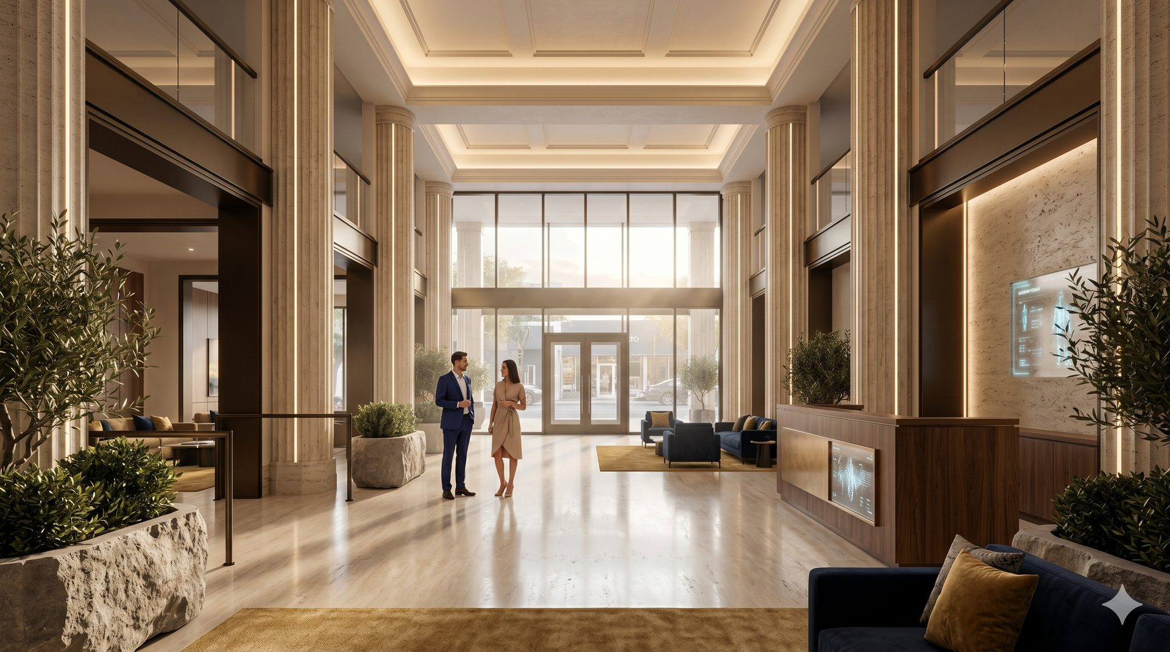
EXECUTIVE SUMMARY
NYC Upper East Side + Salt Lake City
Physician-founded.
Built for national scale.
Two flagship clinics. Operational. Profitable.
COMPANY STRUCTURE
Two live locations. Hybrid corporate + franchise model. Cash-pay, high-margin, physician-led — ready to scale.
CEO
James Zimbler
Leads raise · franchise dev · WFG structure
CMO / Founder
Dr. Ajit Dhaliwal, MD
2
96%
Physician founder · IRB lead · clinical strategy
COO
Vincent Butta
Live Locations
Gross Margin
Operations · systems · multi-site expansion
Clinical Director
Dr. Ravneet Dhaliwal
$40K+
25–40%
Standards · quality · physician recruitment
IP Engine
Dr. Morris · Fulcrum Labs
Elite Program
EBITDA / Clinic
Patented vital monitoring · IRB protocols
Research & Training
Dr. Ali Khan · USMLE100
IRB governance · 600+ physicians trained
Longevity
Joint & Pain
Hair Restoration
Biz Dev
Jaye Patel
Aesthetics
Sexual Health
Total Transformation
Investor relations · partnerships · franchise pipeline

Slide 4

CORPORATE STRUCTURE
The Wellness Franchise Group
Parent holding company unifying RegenHealth Physicians and Regen Wellness Center under a single franchise + IP platform.
THE WELLNESS FRANCHISE GROUP · Parent Holding Company
REGENHEALTH PHYSICIANS
REGEN WELLNESS CENTER
Physician-Led Regen Medicine · NYC + SLC
Fitness + Wellness Mid-Size Format
— Clinics · Franchise / Licensing · MSO
— Fulcrum Performance Labs IP
— IRB-backed research protocols
— 25–40% EBITDA per location
— Stem cell · PRP · Exosome · Peptides
— Fitness · Yoga · Red Light · Massage
— Nutrition · Health Pool & Spa
— Embedded RegenHealth clinical suite
— Membership + clinical revenue model
— 3,500–4,000 sq ft format
$3.25M Raise
$10M Pre-Money
50+ Locations
3 Tier Model

Slide 5
TRANSACTION STRUCTURE
506(b) SAFE · April 2026
$10M
20%
$3.25M
Pre-Money Valuation
SAFE Discount
Target Raise
Round 1 — 506(b) SAFE
Round 2 — 506(c) Public Round
Raise:
$3,250,000
Following the close of Round 1, RegenHealth will launch a 506(c) general solicitation targeting an additional $3M–$5M at an updated valuation. 506(c) allows public advertising to all accredited investors.
Pre-Money Valuation:
$10,000,000
Vehicle:
SAFE — 20% discount at conversion
Investor type:
Accredited investors · Pre-existing relationship
Target: $3M–$5M additional
Why SAFE?
Converts to equity at next priced round · No interest or maturity date · 20% discount rewards early investors · Clean cap table for institutional rounds
*SAFE holders are not equity holders until conversion event

Slide 6
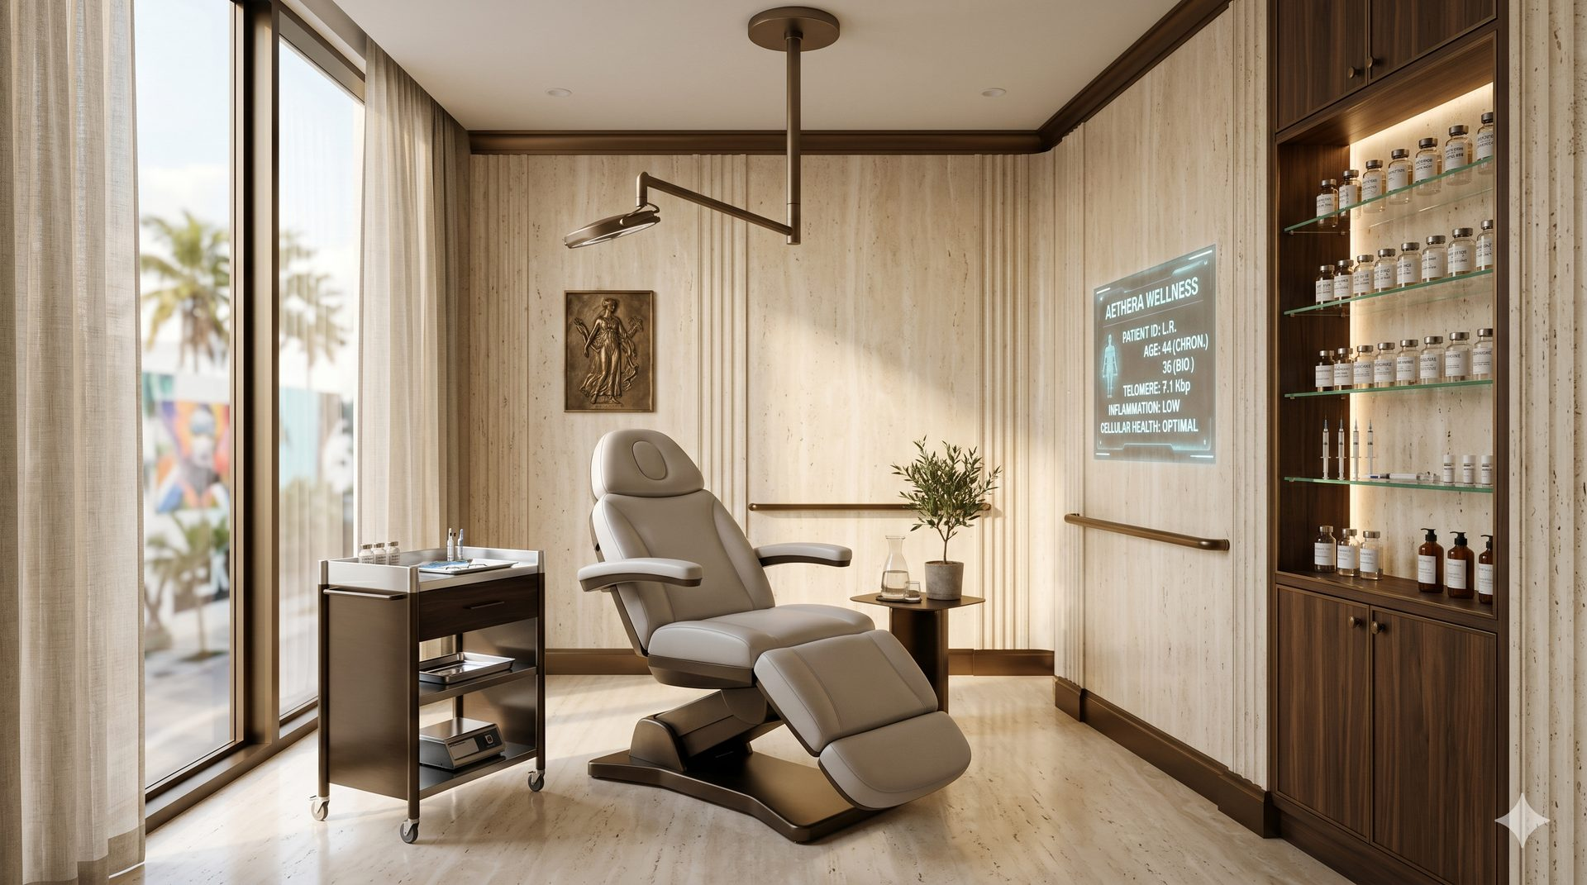
CLINICAL OFFERING
Six Categories · Non-Surgical · Cash-Pay · High-Margin
Longevity
Joint & Pain
Hair Restoration
UC-MSC stem cells · IV peptides (BPC-157, TB500, MOTS-c) · SS-31 · exosomes
Periforaminal MSC injections · PRP · regenerative biologics — no epidurals
PRP + exosome protocols · MSC-enhanced therapies · scalp regeneration
Aesthetics
Sexual Health
Total Transformation
Microneedling · exosomes · compounded topicals · skin rejuvenation
PT-141 · Kisspeptin · PRP · MSC protocols — male & female
Comprehensive longevity + performance programs — Elite tier $40K+
Essential · Advanced · Elite | $2,000 – $40,000+ per program

Slide 7
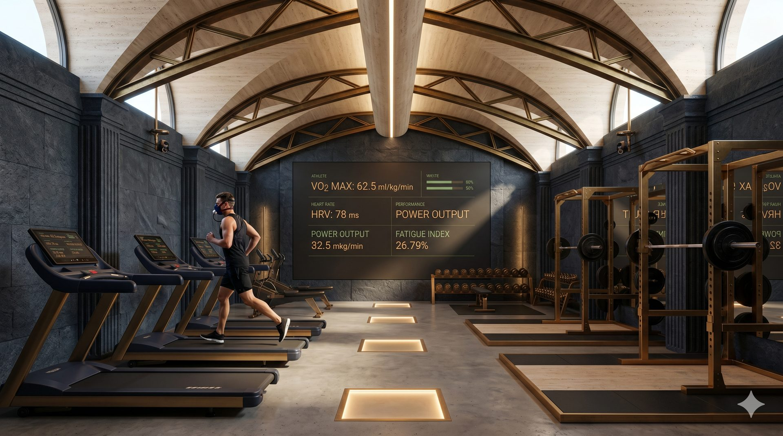
BUSINESS MODEL & TRACTION
Proven unit economics · Two live locations
2
96%
$40K
Yr 2
Live
Locations
Gross
Margin
VIP
Program
Projected
Profitable
Corporate Clinics
Franchise & Licensing
$25M+
— NYC flagship — 4,300+ patient database
— SLC opened April 2026 — standalone
— 25–40% EBITDA direct margins
— $2K–$40K+ per program
— Proof-of-concept for franchisees
— Turn-key clinic-in-a-box system
— MSO licensing for physician-owned states
— 6–8% ongoing royalty per location
— $50K–$75K initial franchise fee
— 50+ clinics targeted over 5 years
Projected 5-Year Franchisor EBITDA
High-ticket · High-margin · Recurring revenue

Slide 8
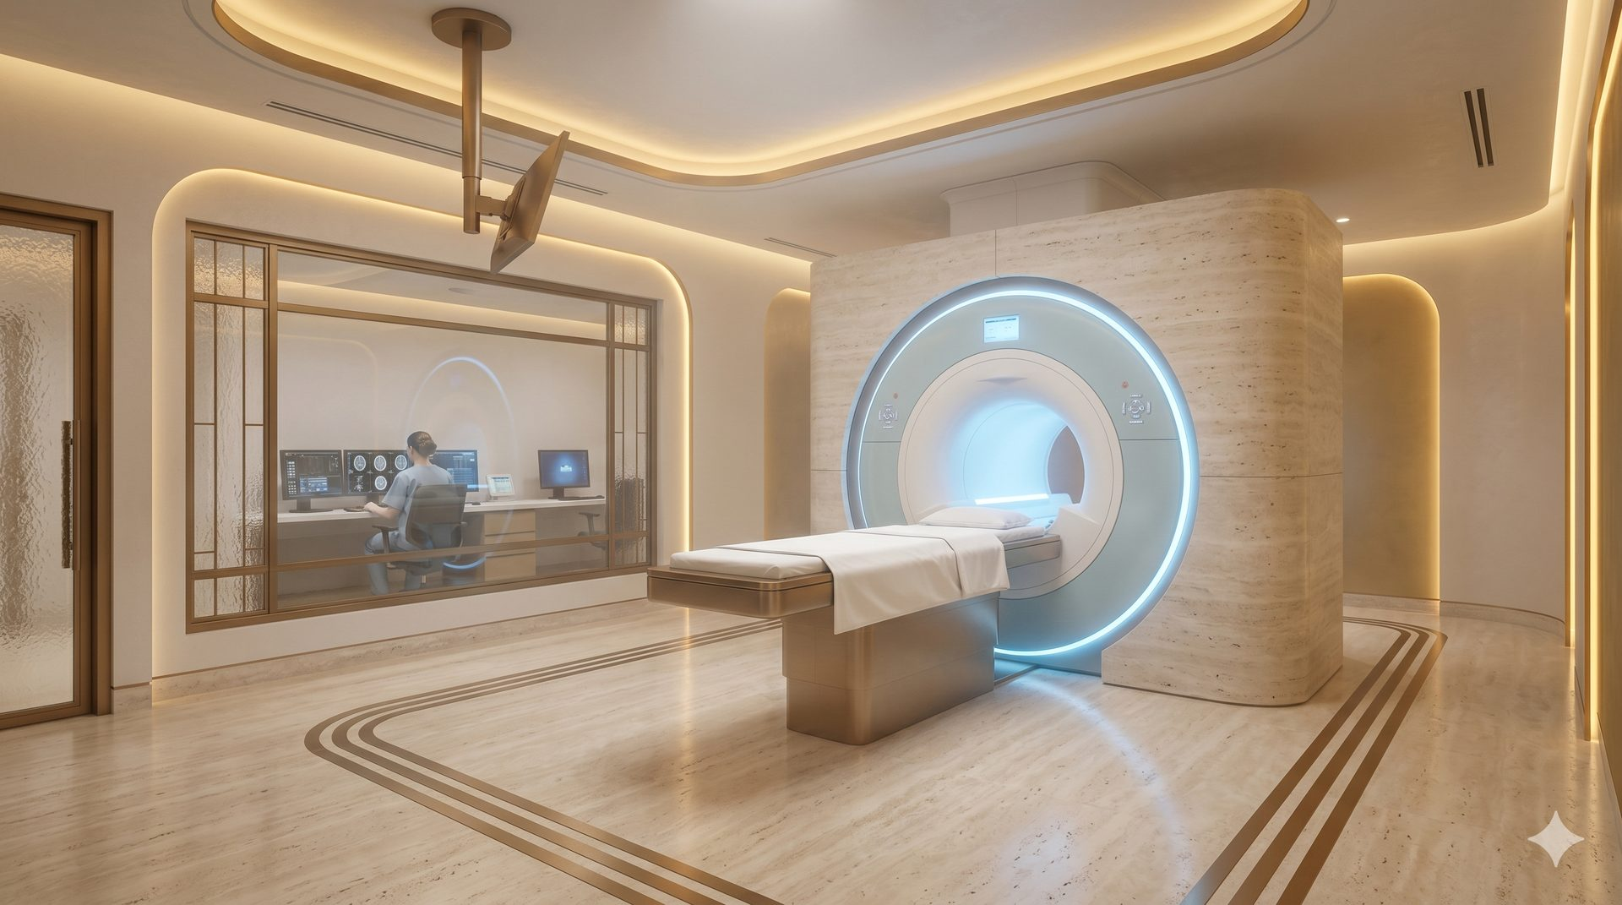

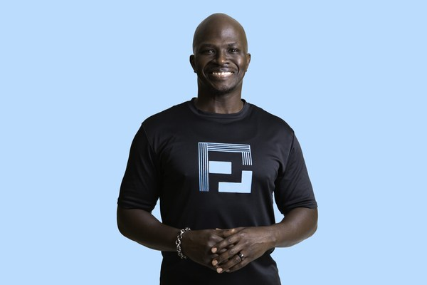


FULCRUM PERFORMANCE LABS
Proprietary IP Engine
Dr. Morris embeds Fulcrum's patented technology into every RegenHealth location — creating a clinical moat no competitor can replicate.
Dr. Morris
Patented Technology
Clinical Director, Elite Human Performance · Fulcrum Performance Labs
— Detects vitals via standard cell phone camera
— No wearable required — non-invasive
— HR · HRV · Respiratory rate · Stress indicators
— NFL Alumni Health program architect
— Created protocols for elite pro athletes
— Founder, Fulcrum Performance Labs
— Patented remote vital monitoring system
Active Locations
New York City — Active
Lee, New Jersey — Active
Dominican Republic — Resort — TBD
Fulcrum's IP becomes a competitive moat — differentiating every RegenHealth location.

Slide 9
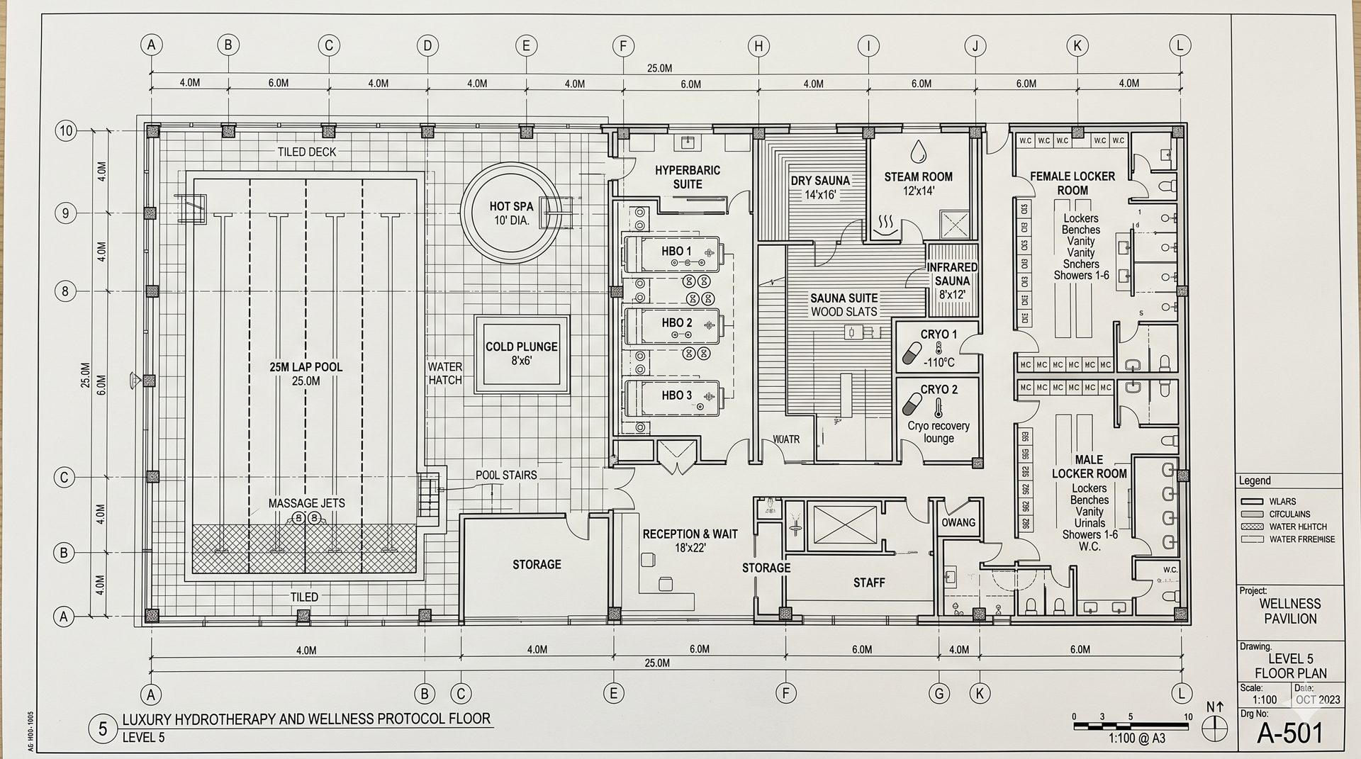
MARKET OPPORTUNITY
$1.8 Trillion Global Wellness Market
Regenerative medicine growing to $132B by 2030 · RegenHealth at the intersection of all three sectors
01
02
03
Regenerative Medicine
Med Spa & Aesthetics
Longevity & Optimization
$38B → $132B by 2030
$19B U.S. · +12% / yr
$27B Recovery tech 2027
— Hair restoration: $12B U.S. market
— Adults 40+ fastest-growing buyer
— Post-COVID demand surge
— Stem cell & exosome market exploding
— Avg ticket: $500–$2,500/visit
— 90%+ cash-pay — no insurance
— High repeat-visit frequency
— Fastest-growing category
— Sexual wellness: $40B+ globally
— C-suite + high-performer ICP
— Peptide & IV therapy exploding
— Membership model emerging

Slide 10
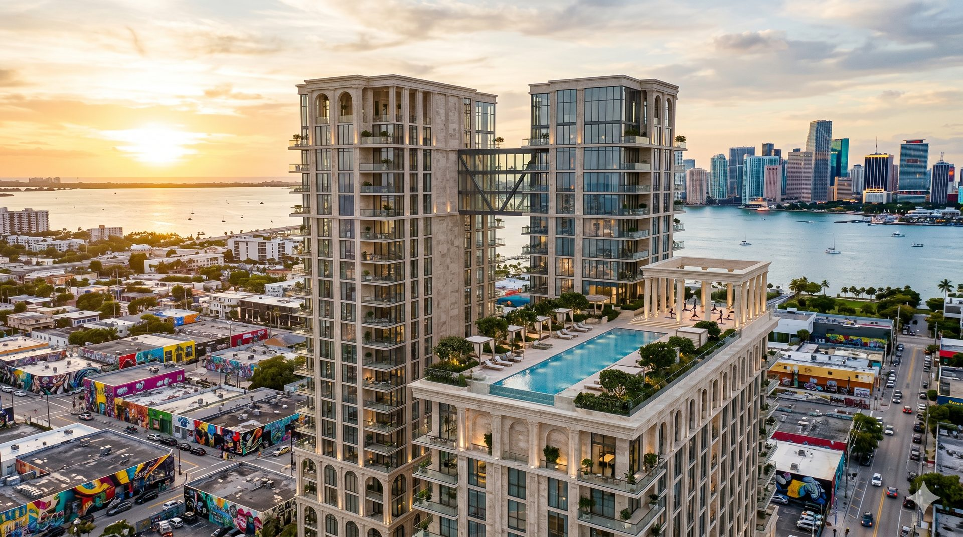
TIERED LOCATION MODEL
Three Tiers — Maximum Market Penetration
01
02
03
SATELLITE CLINIC
REGEN WELLNESS CENTER
AETHERA INSTITUTE
~1,000 sq ft · RegenHealth Physicians
3,500–4,000 sq ft · Regen Wellness Center + RegenHealth
163,000 sq ft · Aethera Wellness Institute
— $1.5M – 2.5M revenue / yr
— Lowest CapEx to open
— 6–8% franchise royalty
— Fastest to replicate
— Medical buildings · Hotels · Gyms
— $2M – 4M revenue / yr
— Membership + clinical revenue
— Dual-brand power
— Higher LTV per member
— Standalone · Hotel · Gym conversion
— $4M – 15M+ revenue / yr
— Highest brand valuation
— Institutional LP model
— Destination + franchise
— Resort · Hotel conversion

Slide 11
FRANCHISE & LICENSING STRATEGY
Launch + franchise simultaneously
How It Works
Unit Economics
— Turn-key clinic-in-a-box — protocols, training, brand, tech, supply chain
— MSO Licensing — RegenHealth manages the clinical layer in physician-owned states
— Royalties — 6–8% of gross revenue from each franchisee
— Marketing fund — pooled national brand spend across the system
— Technology — GHL CRM + patient journey tools at every location
— Dual-brand — RegenHealth + Regen Wellness Center launched simultaneously
Revenue / clinic:
$1.5M – $4M / year
EBITDA margin:
25 – 40%
Initial franchise fee:
$50K – $75K
Ongoing royalty:
6–8% gross revenue
Target (5yr):
50+ clinics nationally
Franchisor EBITDA (5yr):
$25M+ potential
Expansion Targets
NYC 2nd Location
Nashville
Austin
Miami
Sacramento
National Rollout

Slide 12
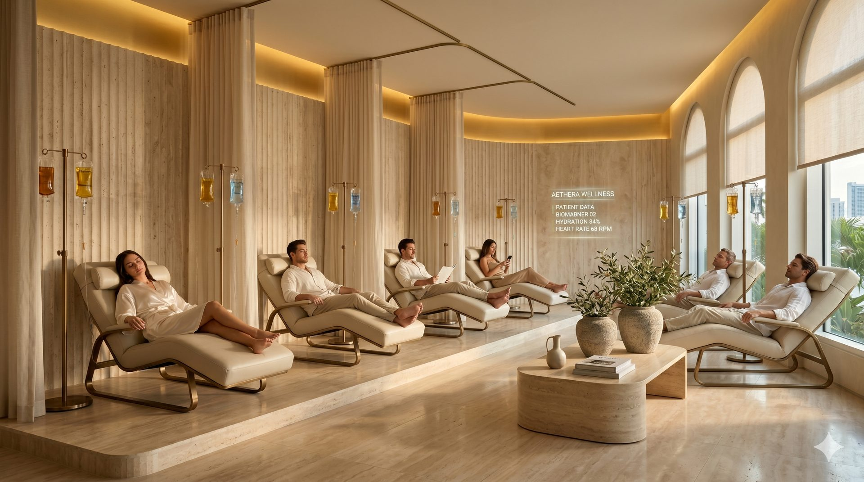
WELLNESS CENTER LICENSING
Embedded Operating Partner — Not a Tenant
RegenHealth enters wellness centers as a full operating partner — we bring the clinical program, they provide the space.
What RegenHealth Brings
What the Partner Gets
— Full clinical program — stem cells, PRP, exosomes, IV peptides, aesthetics, hair
— Physician oversight + credentialed medical staff
— Proven protocols + patient journey playbook
— CRM, scheduling + patient follow-up technology
— Co-branded marketing + patient acquisition support
— Revenue share on all clinical services
— Zero hiring, credentialing, or clinical management
— Turn-key — RegenHealth runs the entire clinical division
— Premium physician-led brand positioning
— Higher member LTV — wellness clients become regen patients
Fitness & Health Clubs
Med Spas
Luxury Hotels
Corporate Wellness
Chiro & PT Clinics
Concierge Medical

Slide 13
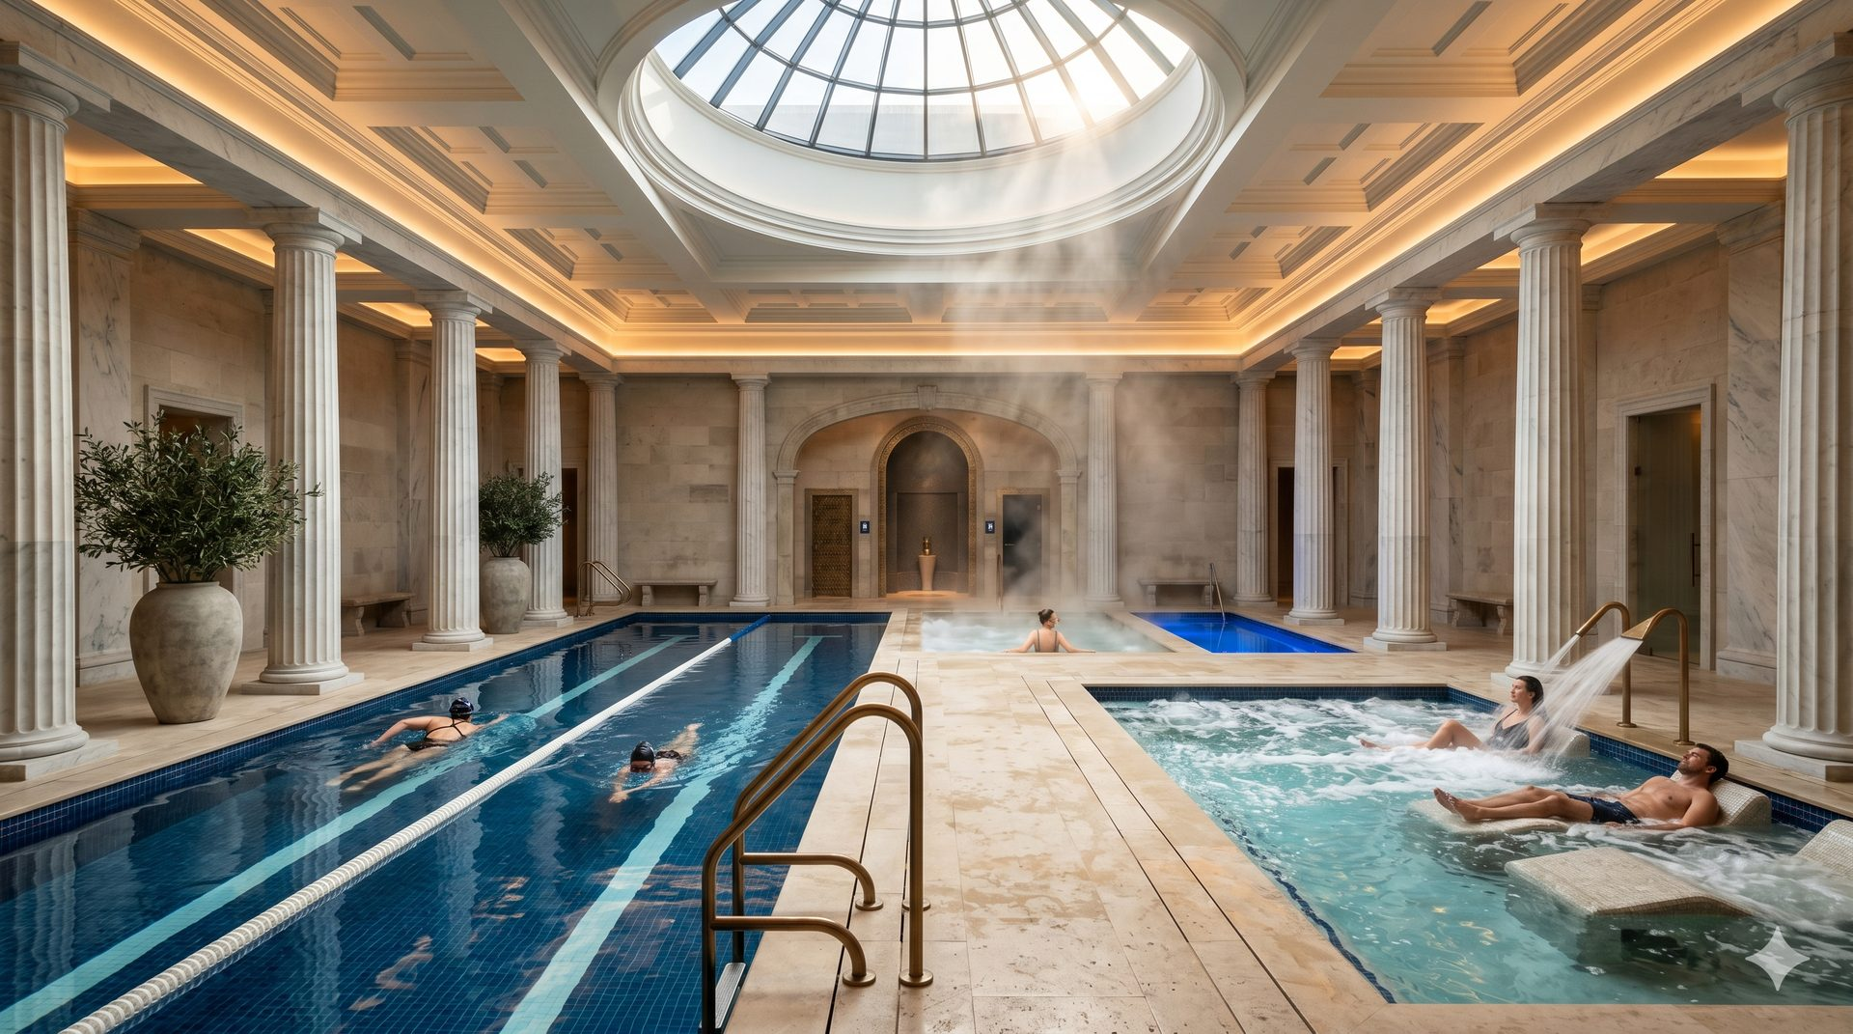
FUTURE VISION
Integrated Wellness Centers
Regen medicine is the core. Integrated wellness becomes the growth engine — amplifying distribution and adding recurring revenue.
Today — RegenHealth Core
Future — Regen Wellness Center
Aethera Institute — Tier 3
— Physician-led regenerative medicine clinics
— NYC + SLC — 2 live, profitable locations
— Franchise/licensing pipeline launching now
— Cash-pay, high-ticket, high-margin
— Protocol-driven, replicable model
— Fitness + regen + wellness under one roof
— Lower CAC via ecosystem cross-sell
— Higher LTV — members become clinical patients
— Membership revenue augments high-ticket procedures
— Tier 2 rollout alongside franchise expansion
— 163,000 sq ft full-scale wellness hotel
— Flagship Wynwood Miami development
— Institutional LP model — $4M–$15M+ revenue
— Destination medicine + global brand
— Series A scope — $50M target raise

Slide 14
FINANCIAL PROJECTIONS & USE OF PROCEEDS
5-Year Model · Conservative Estimates
$52M
$50M+
Yr 5 Revenue
$28M
$25M
$22M
Yr 5 EBITDA
$10M
$100–180M
$3M
Yr 5 Valuation
Yr 1
Yr 2
Yr 3
Yr 4
Yr 5
Revenue
EBITDA
USE OF PROCEEDS — $3,250,000
01 OPERATIONS / WORKING CAPITAL
02 CLINICAL EXPANSION
03 FRANCHISE LAUNCH
$1,000,000
$1,250,000
$1,000,000
Marketing $450K · Exec compensation $350K · Legal/compliance $200K
NYC 2nd location · Equipment · Tech platform · USMLE100 IRB integration $50K
FDD filing · Physician training · Franchise BD · Fulcrum co-locations $200K

Slide 15
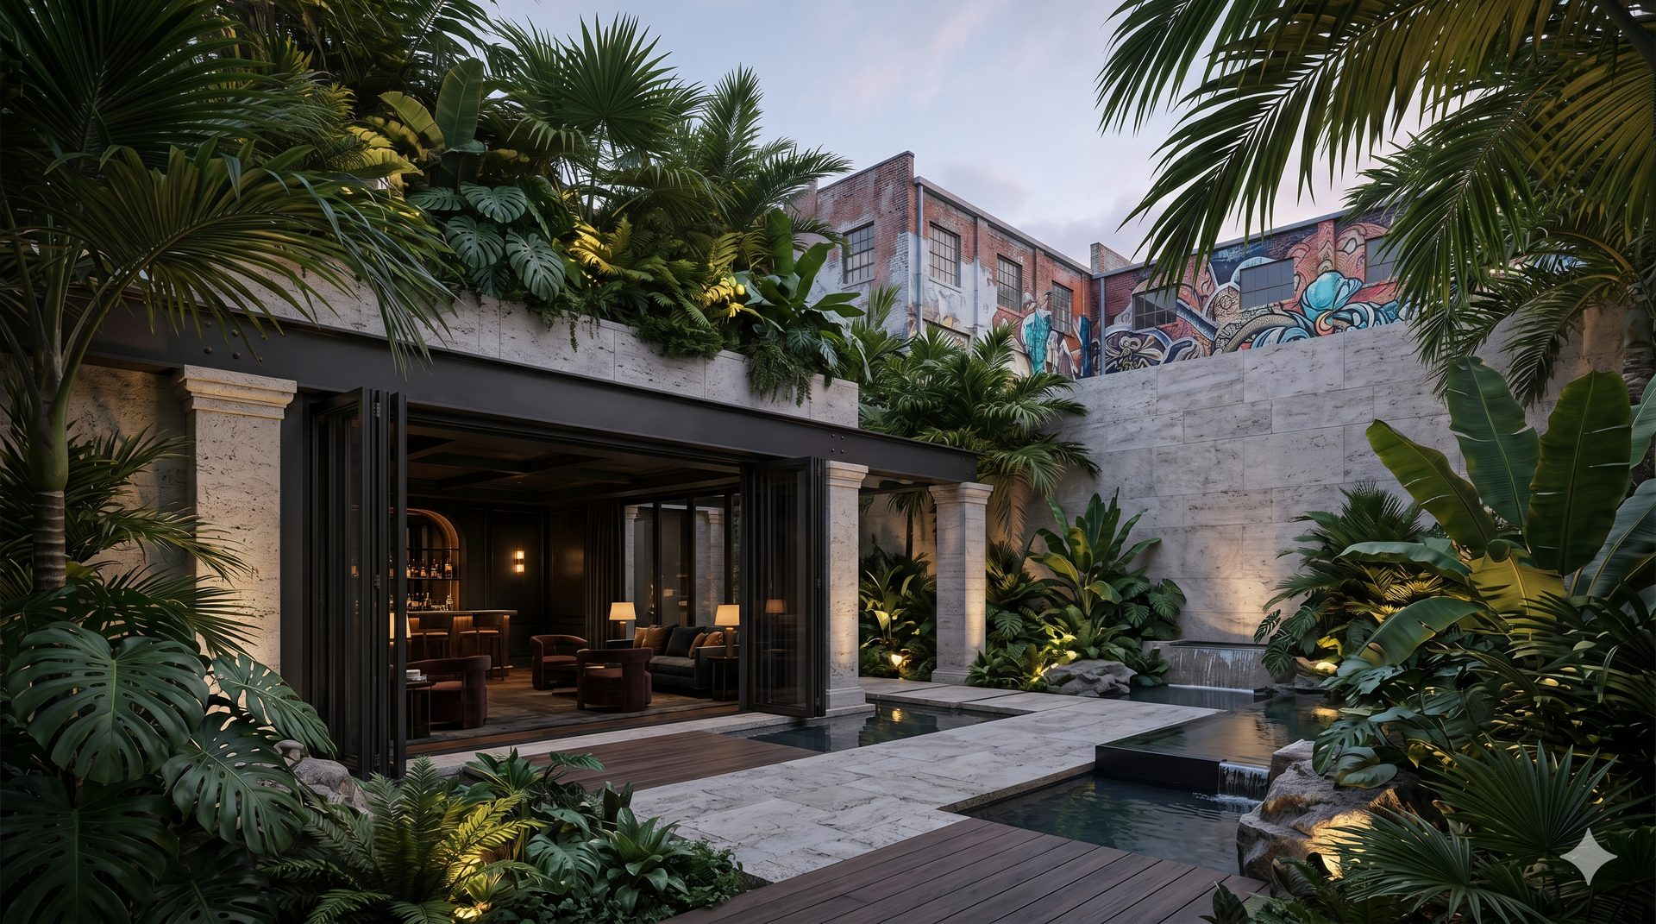
POST-RAISE MILESTONES
12-Month Roadmap
Q2 2026
Q3 2026
Q4 2026
Q1 2027
FOUNDATION
LAUNCH
SCALE
MOMENTUM
0–90 days
90–180 days
180–270 days
270–365 days
— 506(b) + 506(c) raise closes
— Legal + compliance finalized
— FDD filed
— $3.25M fully deployed
— NYC 2nd location opens
— Franchise sales begin
— Tech platform live
— Physician training program
— First franchise signed
— Nashville + Austin expansion
— Memberships launched
— $500K+/month revenue target
— 5+ franchise commitments
— Valuation re-rate
— IPO / reverse merger prep
— $2M+/month run rate
Capital deployed with discipline. Every dollar tied to a revenue-generating milestone.

Slide 16

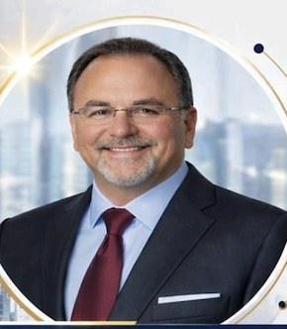
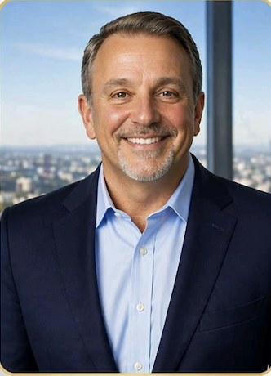

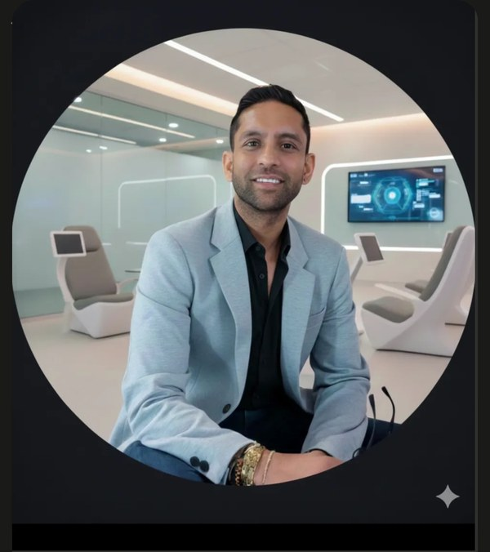
LEADERSHIP TEAM
Physician-led · Operator-executed · Performance-science driven
Dr. Ajit Dhaliwal, MD
James Zimbler
Vincent Butta
Dr. Ravneet Dhaliwal
Founder & Chief Medical Officer
Chief Executive Officer
Chief Operating Officer
Clinical Director & Partner
AK
Dr. Morris
Dr. Ali Khan, MD
Jaye Patel
Clinical Director, Elite Human Performance
Clinical Director of Research & Medical Training
Director of Business Development
Fulcrum Performance Labs
USMLE100 — Founder

Slide 17

PARTNERS & AFFILIATIONS
Institutional relationships that validate the platform
RegenHealth's clinical credibility is anchored by elite sports medicine, research, and performance partnerships.
Fulcrum Performance Labs
NFL Alumni Health
Pro Football Legends
JIV — Just IV
Embedded IP engine · Patented vital monitoring · IRB-validated protocols
Dr. Morris — program architect · Protocols proven on elite athletes
Partner affiliation · Clinical protocols for retired professional athletes
Joint venture partner · Integrated wellness center co-location model
USMLE100
Clinical Director of Research & Medical Training: Dr. Ali Khan, MD — Founder · 600+ physicians trained · IRB governance, clinical protocol development & physician training across all WFG locations · Research published alongside SpaceX team

Slide 18
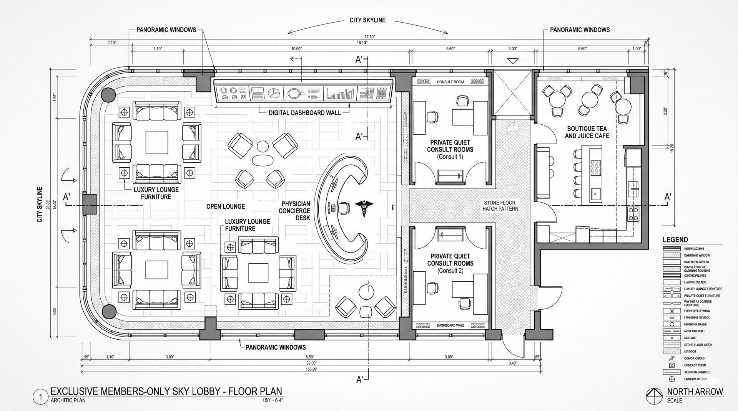
EXIT STRATEGY
Multiple Clear Paths to Liquidity
Private Equity Acquisition
Strategic Buyer
Healthcare PE funds seeking platform roll-up
Wellness platform, med spa consolidator, franchise group
Wellness & longevity platforms · Med spa consolidators
Fitness franchise groups · Healthcare private equity
Public Market
Revenue Recapitalization
Reverse merger or direct IPO — multiple expansion + liquidity
Refinance at higher valuation, return capital, retain control
Sovereign wealth funds · Strategic pharma / biotech
Institutional family offices · Long-term equity holds
Yr 1–2: Build · Yr 3: Franchise · Yr 4: IPO prep · Yr 5: Exit / Recapitalization

Slide 19
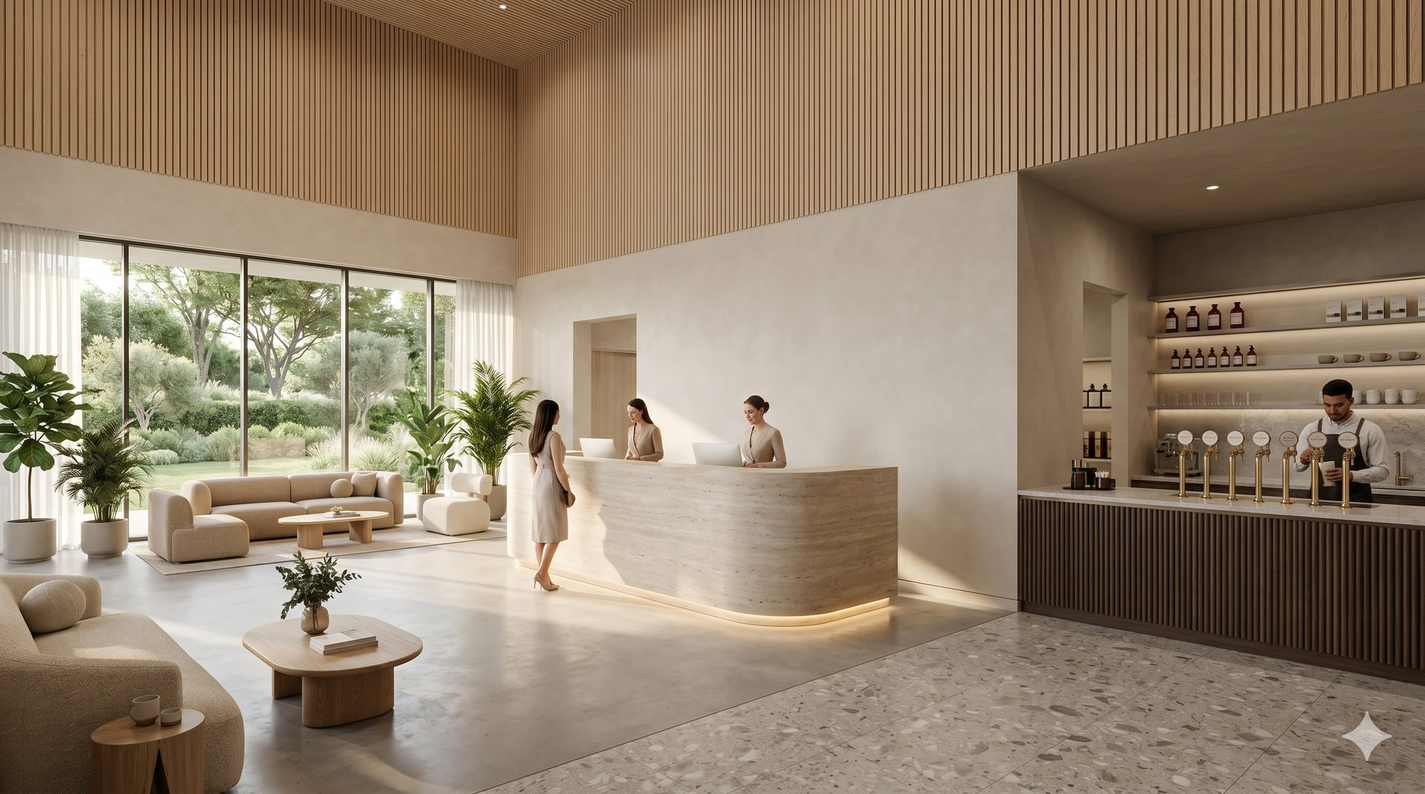
FINAL INVESTMENT NARRATIVE
RegenHealth is NOT:
Why This Wins
— A typical med spa chain
— An insurance-dependent clinic
— A gym or fitness brand
— A single-location operation
First integrated regen medicine + longevity platform — corporate + franchise launched simultaneously
96% gross margin · 25–40% EBITDA per clinic · High-ticket recurring revenue
It Is:
Fulcrum Performance Labs — patented remote vital monitoring IP — no competitor can match
A scalable, physician-led, multi-revenue healthcare platform built for national markets and institutional capital.
Operating today. Proven unit economics. Ready to scale.
Asset-light franchise/MSO model — physician-led brand credibility that can't be replicated
Public market upside — reverse merger path + institutional capital ready
James Zimbler, CEO · Jaye Patel, Dir. of Business Development · Dr. Ajit Dhaliwal, MD — CMO
rhpny.com · wellnessfranchisegroup.com

